Slide 1




ECONOMIC INTEGRATION OF res IN Smart grid Open viva-voce examination and Seminar Presentation on the Thesis submitted By :-- Tanmoy paul (35501618001) Pranta Debnath (35501618011) Sajal gayen (35501618008) Subhendu mondal (35501619002) Dated – 20/06/2022
Ghani Khan Choudhury Institute of Engineering & Technology
Supervisor
Dr. SANDIP CHANDA

Slide 2
CONTENTS
1. Evolution of Power System
2. . Objective of the Research Work
3. Power System optimization
4. Constraints of Optimization
5. Calculation of cost coefficients
6. Cost coefficients of Renewable energy sources
7. IEEE 30 bus system
8. IEEE 118 bus system
9. Cost optimization
10. Loss optimization

Slide 3
contents
11. Penalty based optimization equation
12.Penalty Calculation
13. Penalty based optimization
14.Conclusion
15. Appendix
16. References

Slide 4
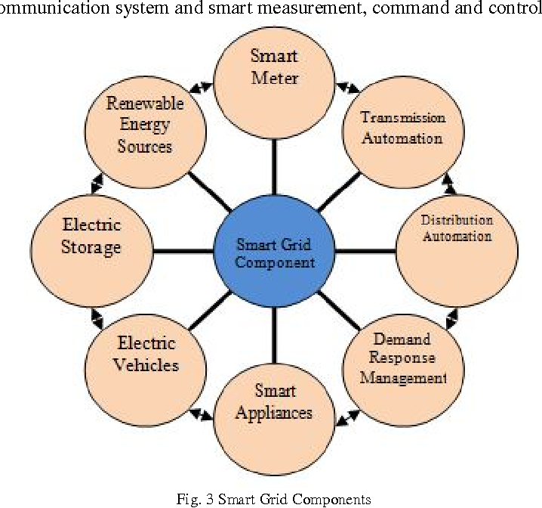
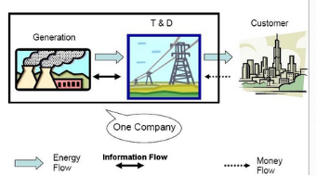

Evolution of Power System

Slide 5
objective of the Research Work
1. To determine the cost coefficient of renewable energy sources through market survey.
2. To find the best possible objective function for power system optimization with Renewable energy sources.
3. To compare the results of traditional generation cost optimization and transmission line active power loss optimization.
4. To develop a new penalty based objective function for optimization incorporating generation cost and power loss objectives.
5. To determine a formula for penalty.

Slide 6
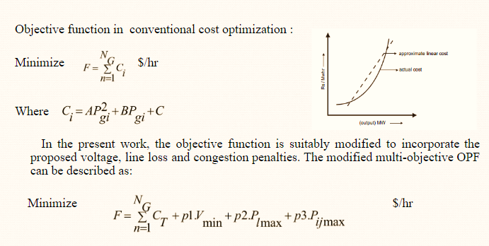
power system optimization

Slide 7
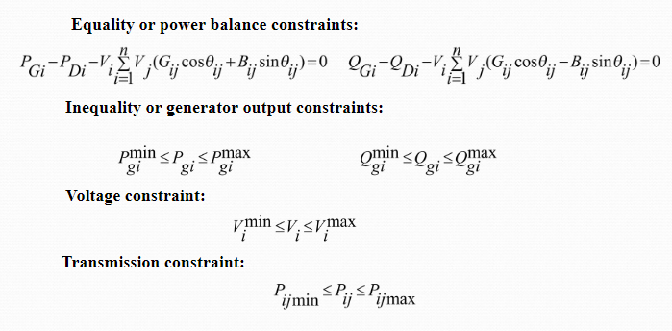
Constraints of Optimization

Slide 8
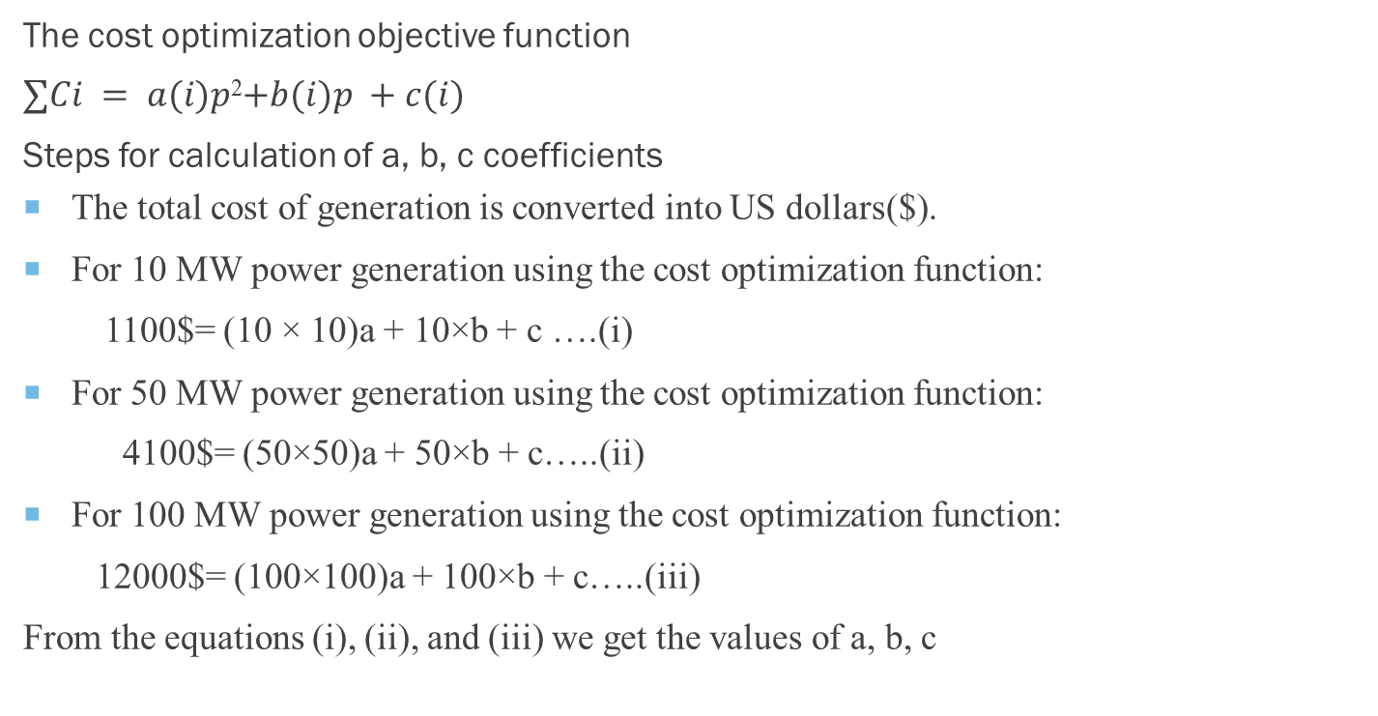
Calculation of Cost coefficients
The cost optimization objective function
$∑Ci = a(i)p$²$+b(i)p +c(i)$
Steps for calculation of a, b, c coefficients
The total cost of generation is converted into US dollars($).
For 10 MW power generation using the cost optimization function:
1100$= (10 × 10)a + 10×b + c ….(i)
For 50 MW power generation using the cost optimization function:
4100$= (50×50)a + 50×b + c…..(ii)
For 100 MW power generation using the cost optimization function:
12000$= (100×100)a + 100×b + c…..(iii)
From the equations (i), (ii), and (iii) we get the values of a, b, c
x-axis power generation, y-axis generation cost

Slide 9
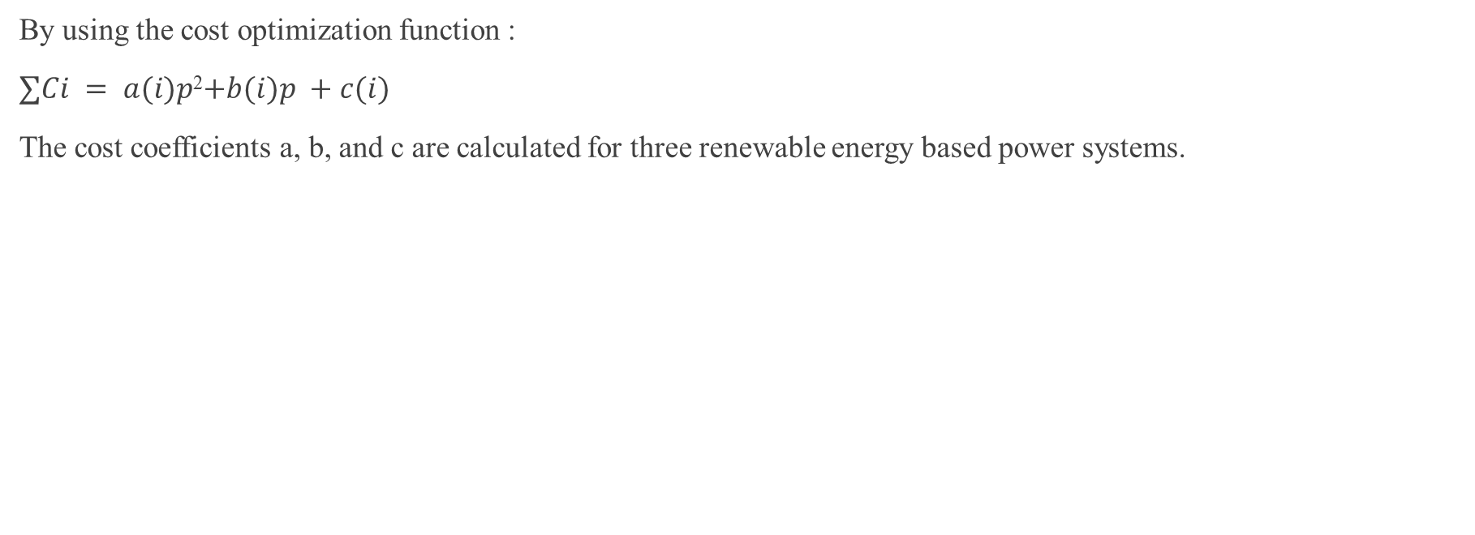
Cost coefficients of Renewable energy sources
By using the cost optimization function :
$∑Ci = a(i)p$²$+b(i)p +c(i)$
The cost coefficients a, b, and c are calculated for three renewable energy based power systems.
RES power System | Cost coefficient ‘a’ | Cost coefficient ‘b’ | Cost coefficient ‘c’
Solar Park by NHPC in Odisha | 0.422 | 74.66 | 311.11
Loktak Power Station under NHPC in Manipur | 0.027 | 75.83 | 138.88
Tata Power Waste Gas Plant in Odisha | 0.277 | 58.33 | 388.88

Slide 10
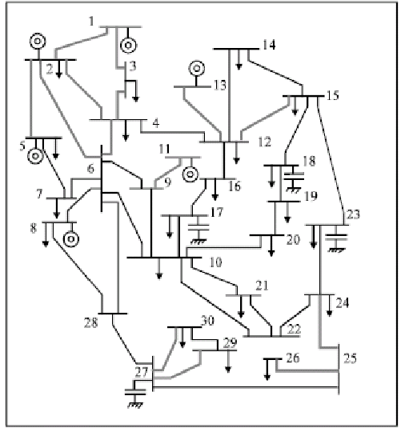
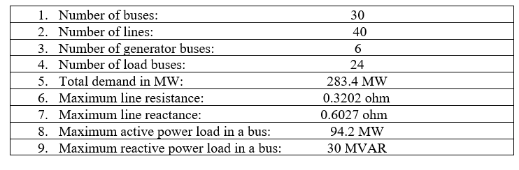
Ieee 30 bus system
The feasibility and effectiveness of the proposed algorithm has been demonstrated in the modified IEEE 30 bus system shown . The summary of relevant data from the modified IEEE 30 bus system is presented in tables. All simulations have been carried out in MATLAB.
Description of the IEEE 30 Bus Test System
Single Line Diagram for IEEE 30 bus System

Slide 11
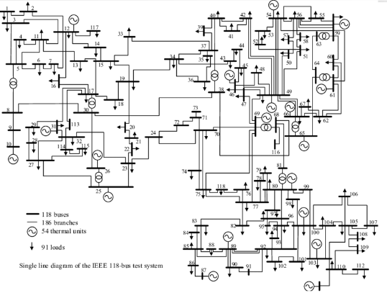
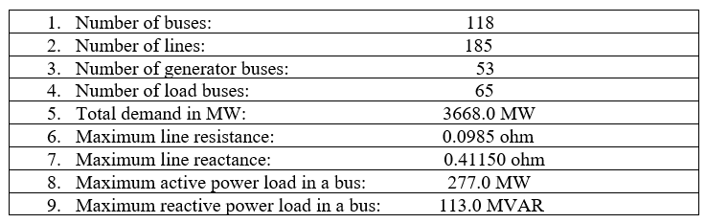
Ieee 118 bus system
The feasibility and effectiveness of the proposed algorithm has been demonstrated in the modified IEEE 118 bus system shown . The summary of relevant data from the modified IEEE 118 bus system is presented in tables. All simulations have been carried out in MATLAB.
Description of the IEEE 118 Bus Test System
Single Line Diagram for IEEE 118 bus System

Slide 12
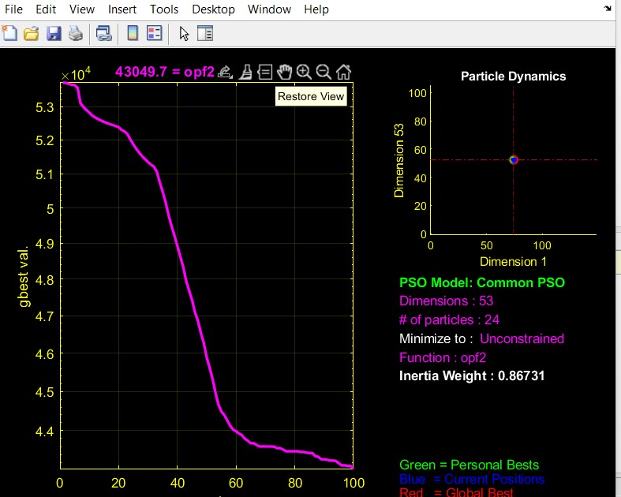
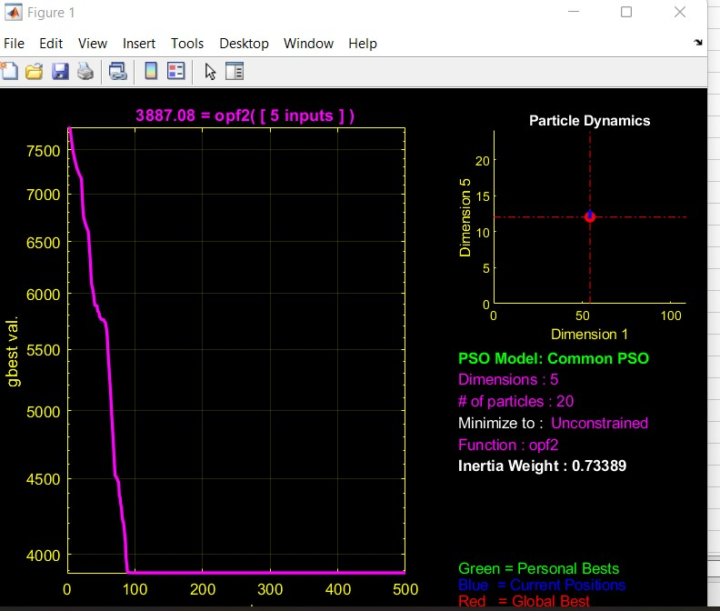
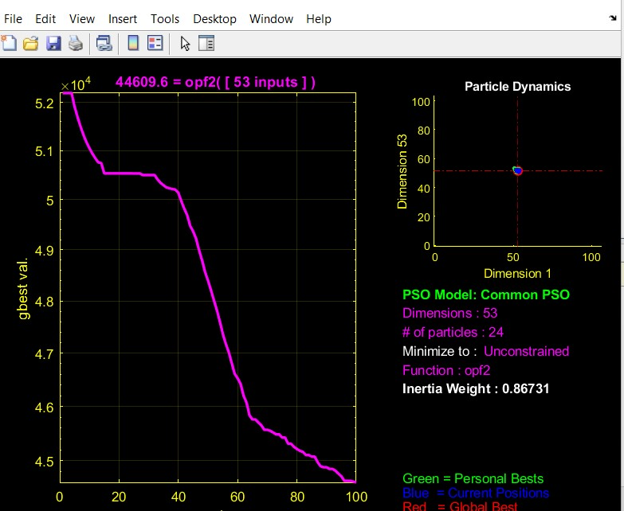
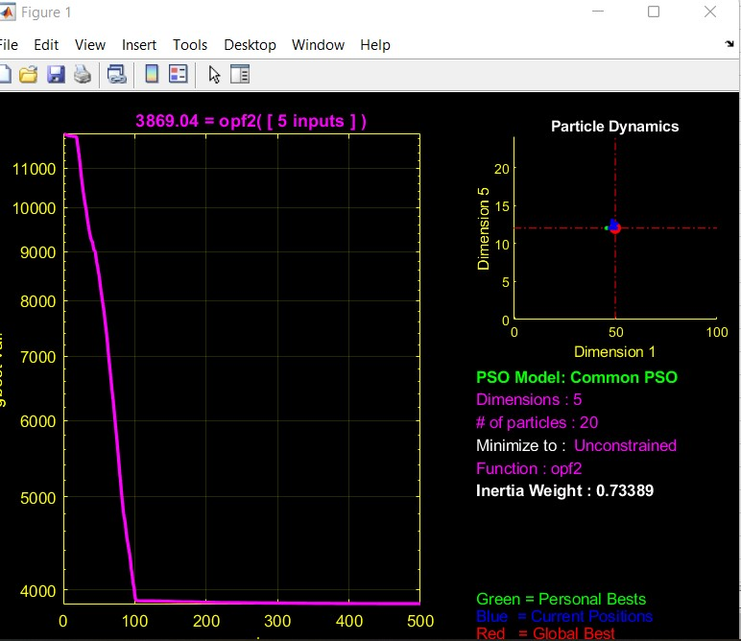
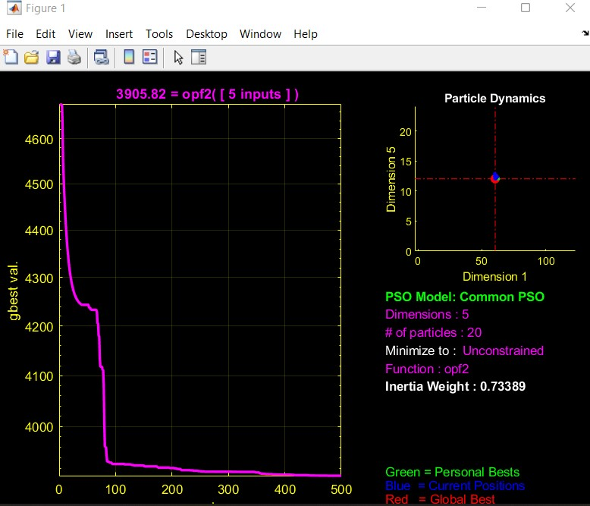
Cost optimization
The cost coefficients of the three RES power system is used in IEEE 118 and IEEE 30 buses system to get the best results for cost optimization function.
 | V (min) | V (max) | Total Loss(MW) | Total Cost($)
Healthy system | 0.9568 | 1.1087 | 2.4256x 10^3 | 43049.6831
N-1 contingency | 0.9577 | 1.1086 | 2.5762 x 10^3 | 44490.5574
N-2 contingency | 0.9577 | 1.1086 | 2386.5 | 44909.6
 | V (min) | V (max) | Total Loss(MW) | Total Cost($)
Healthy system | 0.995647 | 1.06116 | 10.4339 | 3.8690x10^3
N-1 contingency | 0.992773 | 1.06 | 15.3917 | 3.8871x10^3
N-2 contingency | 0.988343 | 1.06 | 20.0283 | 3.9058x10^3
IEEE 118 bus system data for cost optimization.
IEEE 30 bus system data for cost optimization
IEEE 118 bus system output graphs for cost optimization
IEEE 30 bus system output graphs for cost optimization

Slide 13
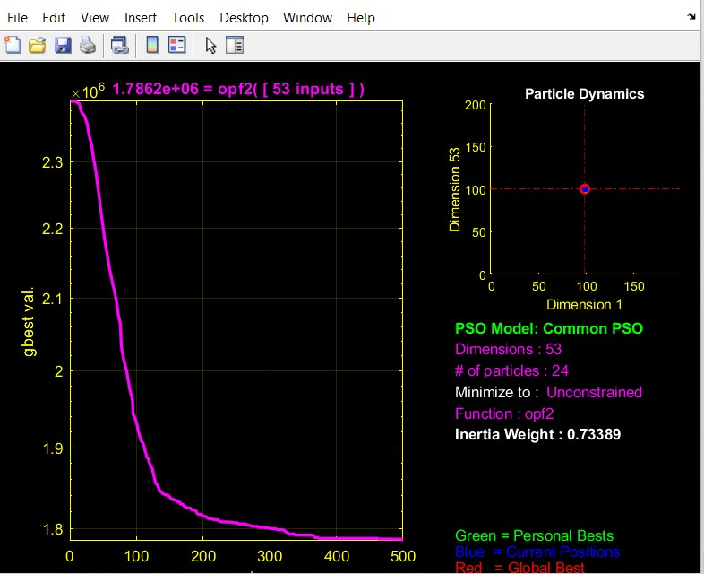
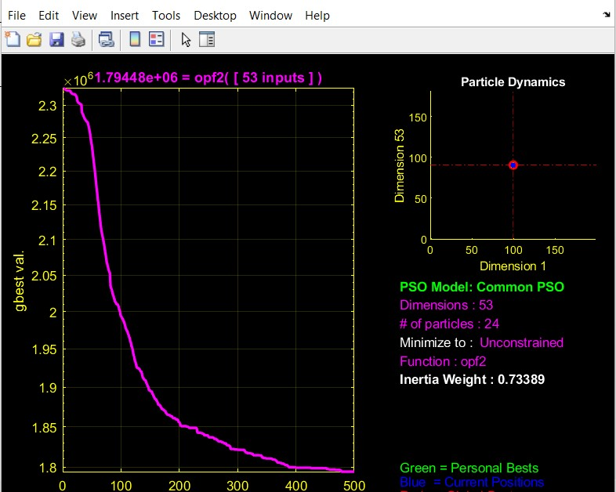
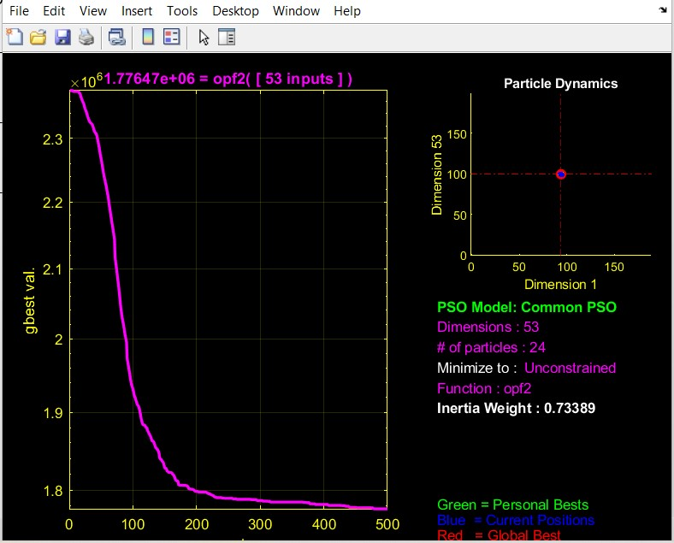
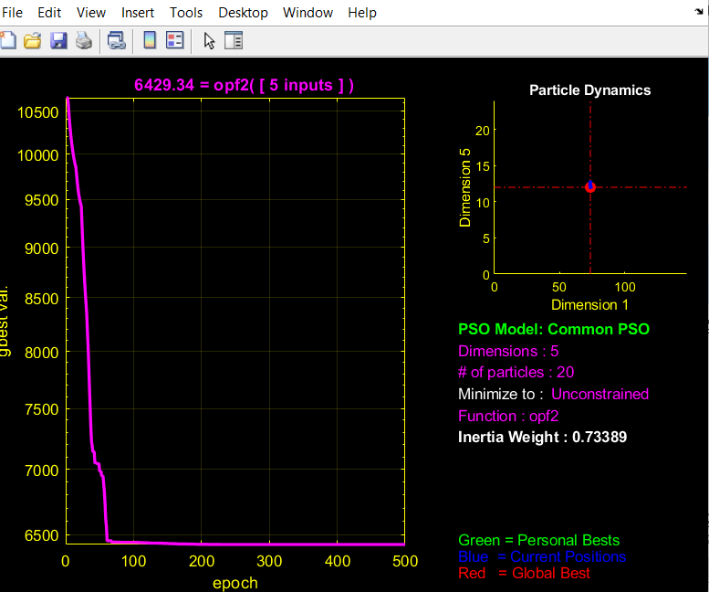
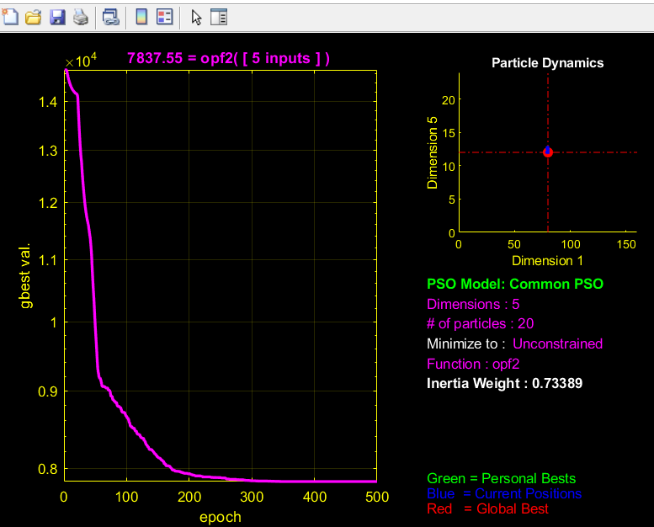
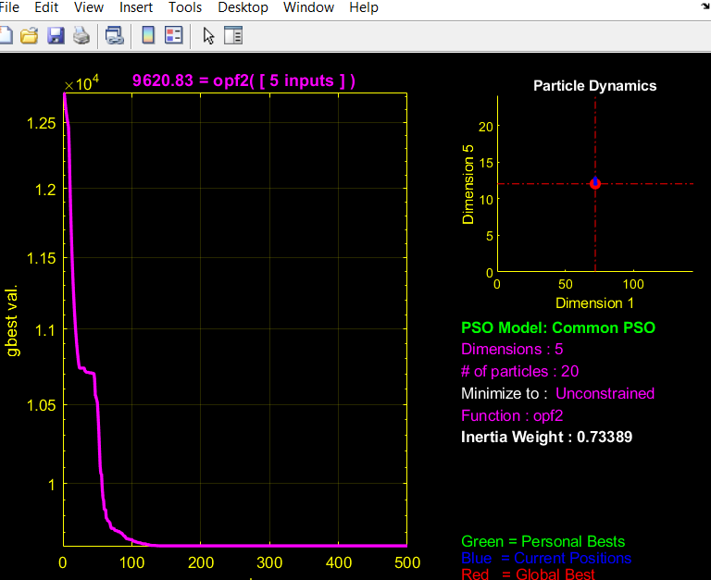
Loss optimization
 | V (min) | V (max) | Total Loss(MW) | Total Cost($)
Healthy system | 0.9577 | 1.1086 | 4733.0 | 1786198.0640
N-1 contingency | 0.9577 | 1.1086 | 4714.5 | 1794479.7147
N-2 contingency | 0.9577 | 1.1086 | 4789.0 | 1776471.1916
 | V (min) | V (max) | Total Loss(MW) | Total Cost($)
Healthy system | 0.9929 | 1.082 | 7.5436 | 6.429x10^3
N-1 contingency | 0.9903 | 1.082 | 10.6921 | 7.837x10^3
N-2 contingency | 0.987019 | 1.082 | 14.445 | 9.620x10^3
The cost coefficients of the three RES power system is used in IEEE 118 and IEEE 30 buses system to get the best results for transmission line heat loss optimization.
IEEE 118 bus system data for loss optimization
IEEE 30 bus system data for loss optimization
IEEE 118 bus system output graphs for loss optimization
IEEE 30 bus system output graphs for loss optimization

Slide 14
Penalty based optimization equation
In the present work, the objective function is suitably modified to incorporate the proposed congestion penalties:
Where,
p1, p2, p3 are the penalties
These penalties are used for calculation.

Slide 15
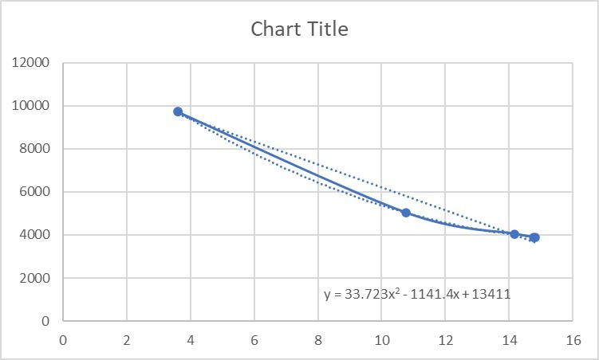
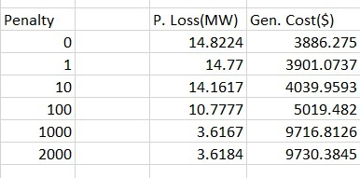
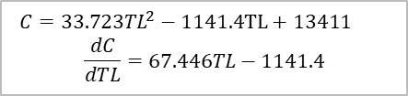
Penalty calculation
Penalty Calculation of IEEE30BUS System
Graph for penalty calculation
x axis- Power Loss, y axis- Generation cost
Calculating penalty formula from graph

Slide 16
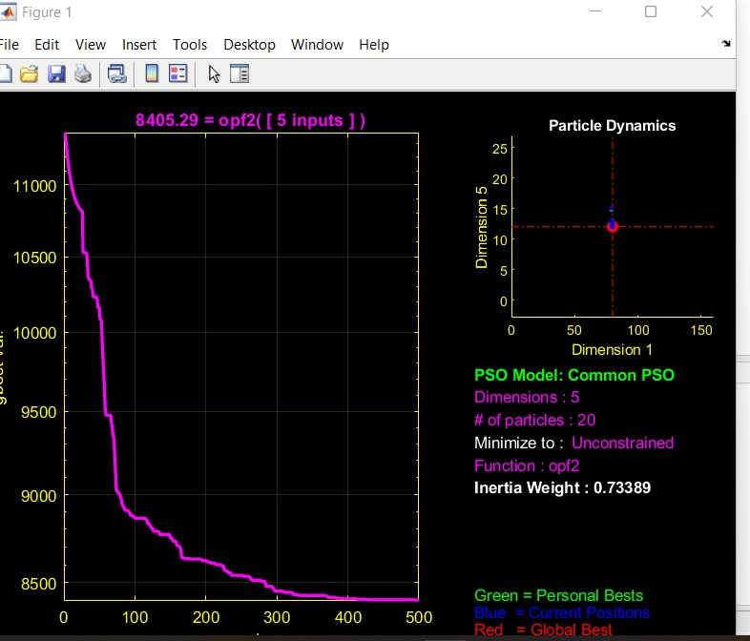
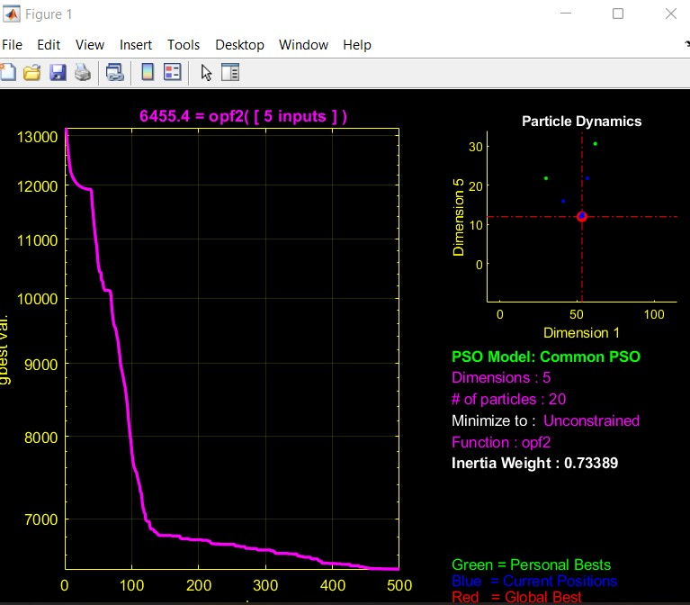
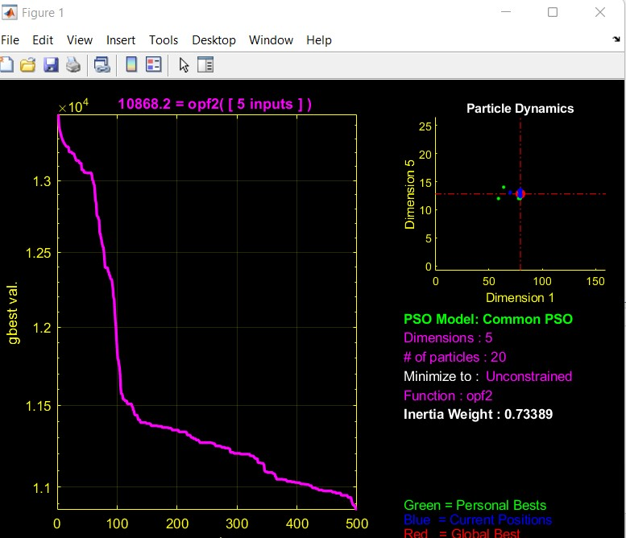
Penalty based optimization
 | V (min) | V (max) | Total Loss(MW) | Total Cost($)
Healthy system | 0.9958 | 1.082 | 3.6182 | 8405.3
N-1 contingency | 0.992 | 1.082 | 3.617 | 9779.5
N-2 contingency | 0.9883 | 1.082 | 3.6178 | 10868.0
The cost coefficients of the three RES power system is used in IEEE 30 buses system to get the best results for penalty based optimization.
IEEE 30 bus system data for penalty optimization
IEEE 30 bus system output graphs for penalty optimization

Slide 17
Conclusion
1. In cost optimization algorithm the cost is minimum but the loss is very high.
2. When we follow loss optimization the generation cost become very high.
3. Penalty based optimization method is basically a compromise between generation cost and loss optimization.
4. The formula for penalty can be found from the correlation between generation cost and power loss with the variation of penalty.
5. This objective function is suitable for the integration of renewable energy sources as the investment cost of these sources are very high.
6. The future results found can be used to develop more advanced algorithms for smart grid.

Slide 18
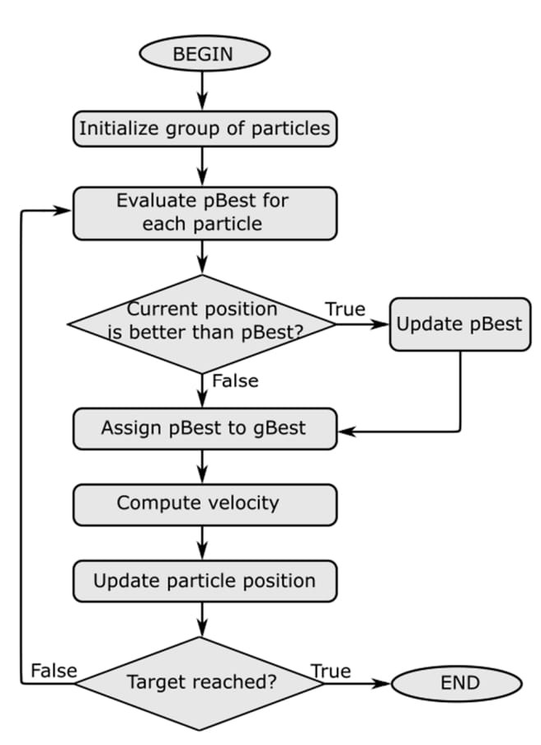
Appendix
Particle Swarm Optimization Technique
PSO algorithm are outlined in the works of van den Bergh and Wang et al.:
• Proximity: it is able to perform simple calculations in time and space.
• Stability: the swarm does not change the behavior regarding every environment change.
• Quality: it is able to detect the quality change in the environment and respond to it.
• Diverse response: it has no limitation in the response to environment change.
• Adaptability: it is able to know if the change is worthy.
PSO algorithm

Slide 19
References
G. M. Huang, N.l Kumar, C Nair, “An OPF based Algorithm to Evaluate Load Curtailment Incorporating Voltage Stability Margin Criteria,” Power Engineering Society Winter Meeting ,IEEE, 2002
K. Selvi, T.Meena, N.Ramaraj, “A Generation Rescheduling Method to Alleviate Line Overloads using PSO,” IE (I) Journal-EL.2005.
Y. Xiaodan, J. Hongjie, Z. Jing, L. Yan, Z. Yuan, “Interface Control Based on Power Flow Tracing and Generator Re-redispatching,” Automation of Electric Power Systems IEEE, 2008.
G.Baskar, M.R. Mohan, “Contingency Constrained Economic Load Dispatch using Improved Particle Swarm Optimization for Security Enhancement,” Electric Power System Research Elsevier, 2008.
E.Muneender, M.D. Vinod Kumar, “Optimal Rescheduling of real and reactive powers of generators for zonal Congestion Management Based on FDR PSO.IEEE T&D Asia, 2009
Sujatha Balaraman, K.Kamaraj, “Congestion management in Deregulated power system using real coded genetic algorithm,” International Journal of Engineering Science and Technology , vol 2, no.11, ,pp. 6681-6690, 2010
S. Balaraman , K. Kamaraj, “Application of Differential Evolution for Congestion management in power system,” Modern Applied Science ,vol 4, no 8, August 2010.
Z. Jinli, J. Hongjie, Y. Xiaodan, “Voltage Stability Control Based on real power flow tracing, Proceedings of CSEE, IEEE,2009.
X. Zou, X. Luo, Z. Peng, “Congestion Management Ensuing Voltage Stability under Multicontingency with preventive and Corrective Controls,” IEEE, 2009.
Hwa-Sik Choi, Seung II Moon, “A new Operation of series compensating device under Line Flow Congestion using the Linear zed Line Flow sensitivity,” Power Engineering Society winter meeting IEEE,2001.
E.M. Yap, M.Al-Dabbagh, P.C. Thum, “UPFC Controller in Mitigating Line Congestion for Cost-Efficient Power Delivery,”Power Engineering Conference IPEC, IEEE, 2006
Xiao-Ping Zhang, L. Yao “A Vision of Electricity network Congestion Management with FACTS and HVDC,” DRPT2008, 6-9 April, 2008 Nanjing China

Slide 20
THANK YOU

